Slide 1
Research on the application of artificial intelligence in medical imaging diagnosis

Slide 2
Contents:
Introduction
Abstract
Existing System
Proposed System
Hardware and software specifications
Modules
System architecture
Use-case diagram
Screens
Conclusion

Slide 3
Introduction:
AI technology can complete tasks such as automatic identification and labelling of lesions, automatic delineation of target areas and 3D reconstruction of medical images through image classification, image segmentation, target detection and image retrieval. It is mainly applied in the stages of screening, diagnosis and treatment of diseases.
According to statistics, medical imaging technology has been widely used in more than 70% of clinical diagnosis. It mainly has the following three functions in clinical practice: auxiliary medical clinical examination (such as identification, marking, determination and classification), injection processing method determination (such as cutting, stroking, sizing and evaluation) and interventional therapy guidance (e.g., 3D visualization).
The combination of computer technology and diagnostic analysis of medical images has an important role in improving the efficiency and accuracy of lesion detection.

Slide 4
Abstract:
This paper first expounds the research status for artificial intelligence technology in medical imaging diagnosis, and illustrates the importance of computer-aided diagnosis with examples; Secondly, the current bottlenecks in the development of computer-aided diagnosis technology are analysed in detail from the aspects of technology, industry and application; Finally, based on the previous analysis, the paper puts forward some suggestions on how to better use artificial intelligence technology in medical imaging diagnosis with reference to the current actual situations.

Slide 5
Existing system:
According to the statistics of the World Health Organization (WHO), among the deaths caused by cancer, cardiovascular disease, diabetes, and chronic respiratory diseases in the world, cancer mortality ranks first, and the number of deaths from the disease accounts for 22.32% of the total number of deaths. However, with the increasing number of hospital patients, the contradiction between supply and demand of medical image analysis continues to increase. In view of this, the emergence of computer-aided diagnosis (CAD) [6] can help doctors to complete the diagnosis and treatment of diseases, and help doctors to obtain image information more quickly and make certain qualitative and quantitative analysis. It has shown great positive effects in intelligent medicine. The main task of CAD system is to help doctors to make a clear division and accurate identification of the lesion area. The time-saving and efficient detection helps patients to discover their own diseases in time, proving that the system is suitable for clinical diagnosis of diseases. Deep learning technology has achieved great success in the diagnosis of medical imaging.. However, there is still a certain gap between AI-based medical imaging diagnosis technology and clinical application.

Slide 6
Proposed systems:
Referring to the comprehensive analysis discussed above, how to quickly apply the deep learning-based computer-aided diagnosis technology to clinical diagnosis will be an urgent need for smart medical care to take root. It is particularly important to technically optimize the deep learning algorithm model and establish a high-quality data set, which mainly includes: one is to deepen the research on the joint model of rules and deep learning; The other is to establish a wide range of sources and standardized data sets to improve the quality of training data .More efforts are made to investigate and establish registration specifications for AI software in the industrial field. The training of medical imaging diagnosis models based on deep learning not only focus on the identification and classification of image signals, but also makes comprehensive judgments based on the patient's medical history, symptoms, and other test results. In this way, the overall medical level of artificial intelligence can be further improved, and then the transition from auxiliary examination to predictive diagnosis and auxiliary judgment can be realized.

Slide 7
Hardware and software specifications:
REQUIREMENT ANALYSIS:
The project involved analyzing the design of few applications so as to make the application more users friendly. To do so, it was really important to keep the navigations from one screen to the other well ordered and at the same time reducing the amount of typing the user needs to do. In order to make the application more accessible, the browser version had to be chosen so that it is compatible with most of the Browsers.

Slide 8
Requirement specification:
Functional Requirements:
Graphical User interface with the User.
Software Requirements:
For developing the application the following are the Software Requirements:
Python
Django

Slide 9
Modules:
USER:
The User can register first. While registering, he required a valid user email and mobile for further communications. Once the user registers, then the admin can activate the user. Once the admin activates the user, then the user can login into our system. Users can upload the dataset based on our dataset column matched. For algorithm execution data must be in integer or float format.Here we took different types of images dataset for testing pupose. User can click the Data Preparations in the web page so that the data cleaning process will be started. The cleaned data will be displayed.

Slide 10
ADMIN:
Admin can login with his login details. Admin can activate the registered users. Once he activates then only the user can login into our system. Admin can view the overall data in the browser. He can also check the algorithms Convolutional Neural Network (CNN), Deep Learning algorithms, Artificial Intelligence. All algorithm execution completes then the admin can see the overall accuracy in the web page.

Slide 11
DEEP LEARNING:
The methodology of medical image detection using deep learning based artificial intelligence technology. Images are extracted from the trained dataset. Medical imaging diagnosis using a convolution neural network (CNN) based. Proposed implementation uses two types of datasets. One dataset, which had pre-labelled images and the other one is a set of images, which were labelled manually. Results are tabulated, both algorithms achieve good accuracy, but their application in real situations can be based on the trade-off between speed and accuracy.

Slide 12
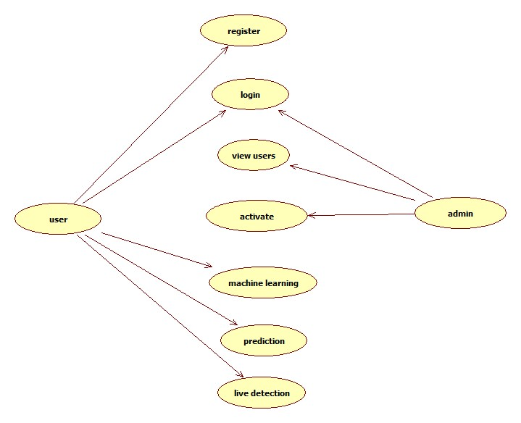
Use case diagram:

Slide 13
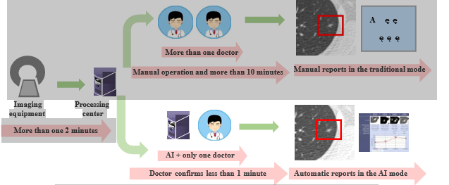
System Architecture:

Slide 14
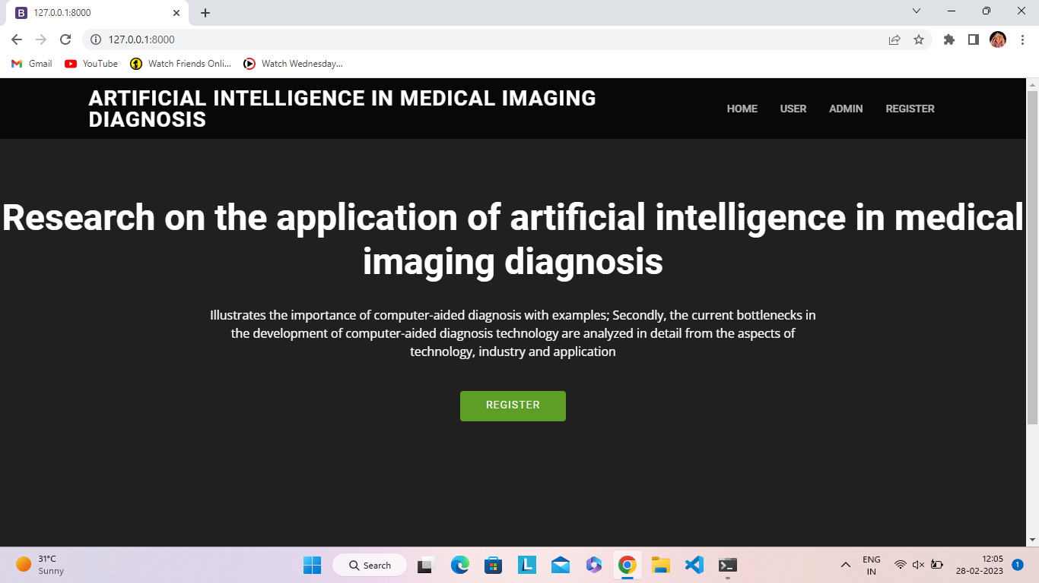
Home page:

Slide 15
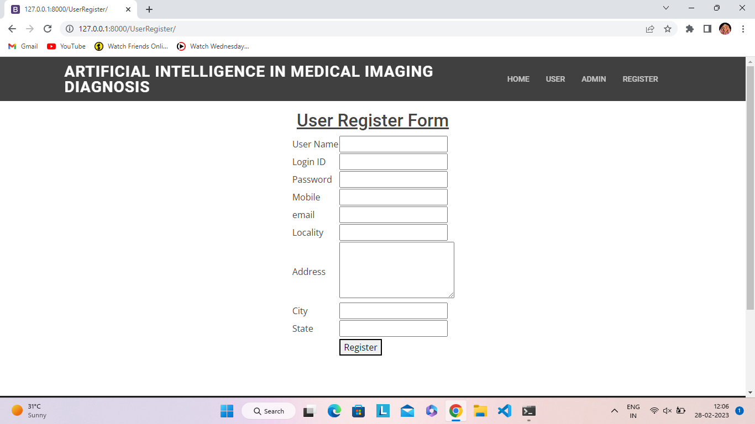
Registration form:

Slide 16
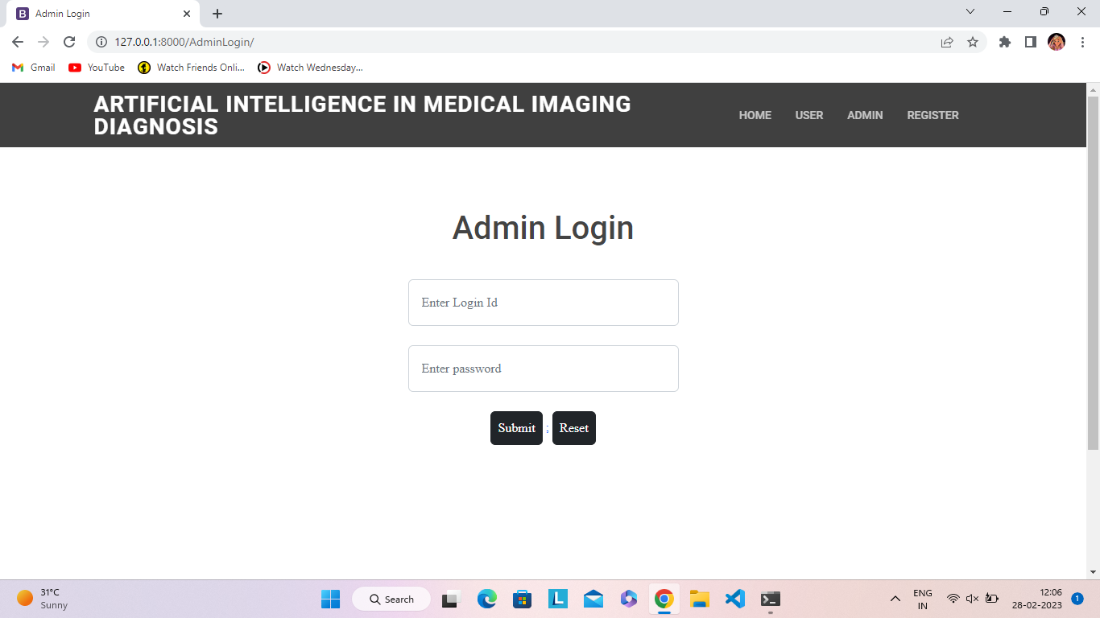
Admin login:

Slide 17
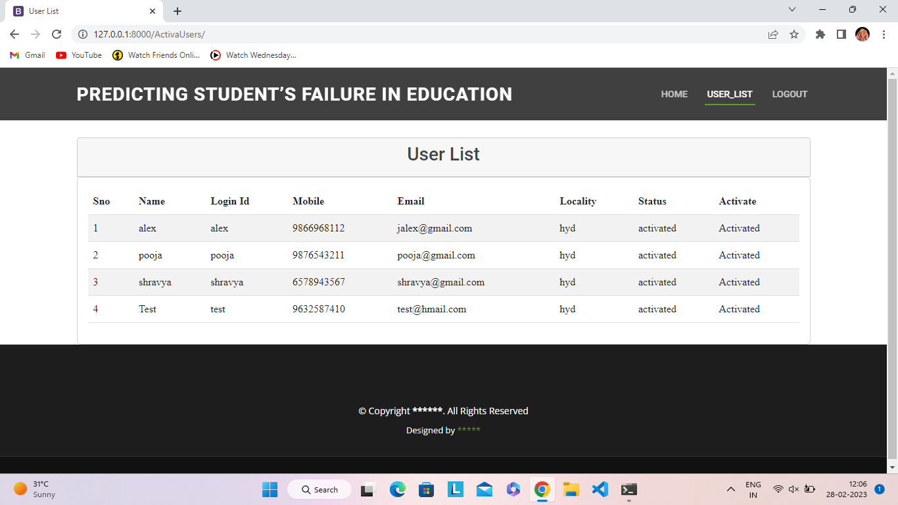
Admin activation:

Slide 18
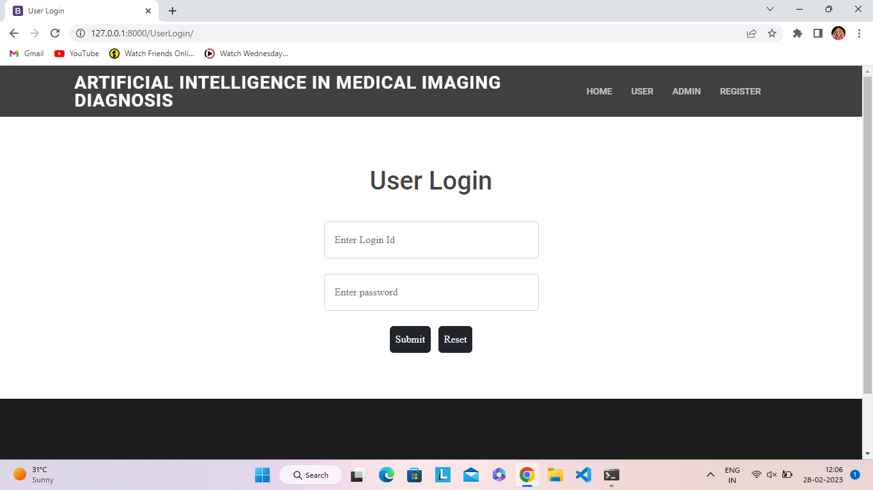
User login:

Slide 19
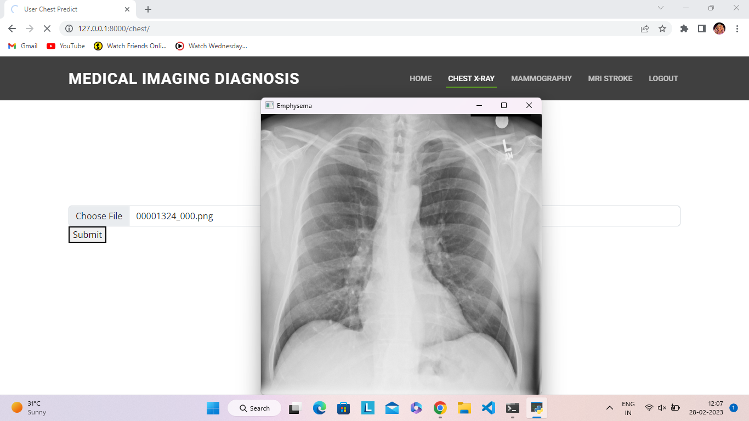
Chest X-ray:

Slide 20
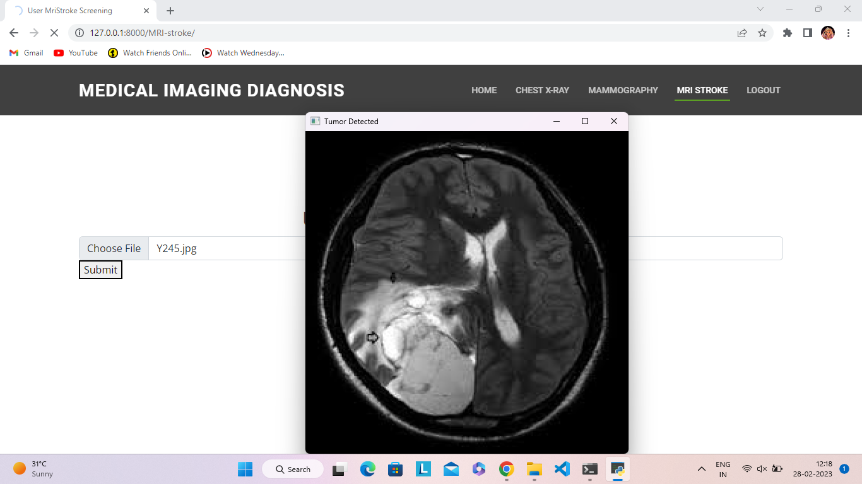
MRI Stroke:

Slide 21
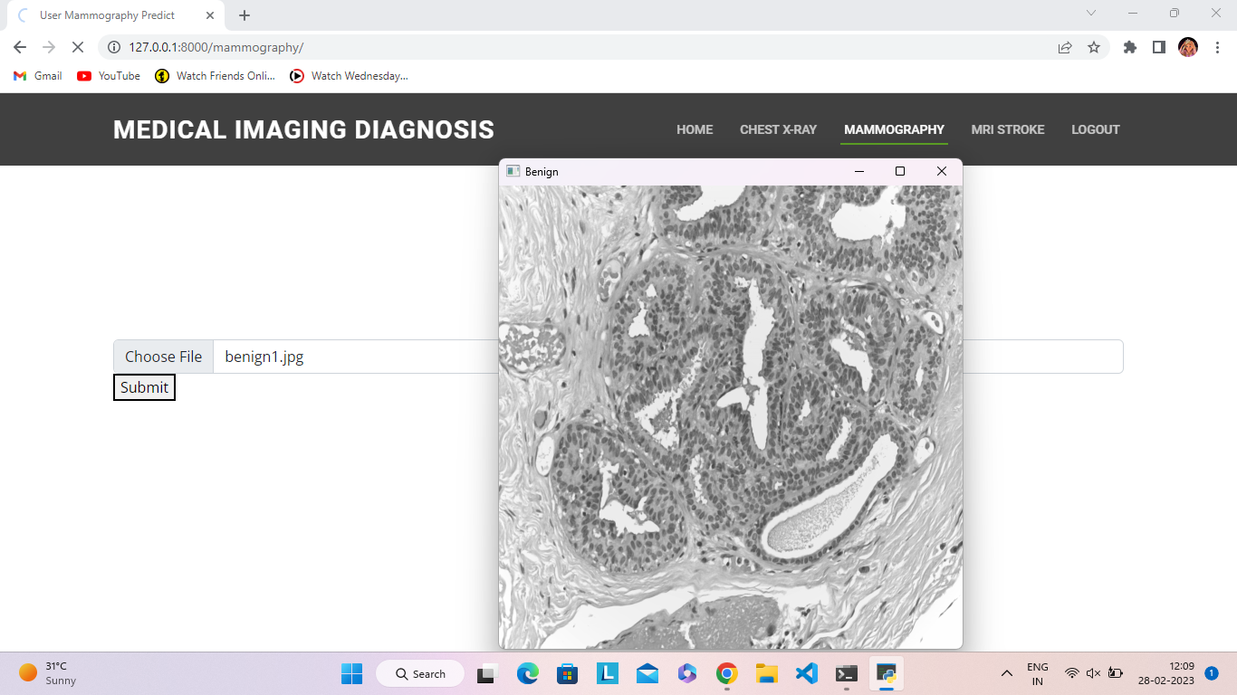
Mammography:

Slide 22
Conclusion:
The paper comprehensively analyses the difficulties existing in the current deep learning-based artificial intelligence technology in medical image analysis, and puts forward corresponding suggestions from the aspects of technology, industry and application. In general, although the AI-based medical imaging computer-aided diagnosis mode can effectively reduce the work intensity of front-line clinical imaging doctors, a lot of practice and exploration are still needed to further improve the effectiveness and reliability of the entire disease diagnosis process. Therefore, how to improve the accuracy of lesion area detection, ensure the detection quality of the auxiliary diagnosis system and provide correct disease diagnosis information, in order to further improve the effectiveness and reliability of the whole diagnosis process, will become the main direction of future research.

